Slide 1

Data Structures
Lecture 15: Sets and Maps

Slide 2




Sets
A Set is a sorted collection of objects provided that the element keys are unique.
Sets sort the element using their Compare structure.
Operations on sets include:
Testing for membership
  Adding elements
  Removing elements
  Union
  Intersection
  Difference
  Subset
Sets are implemented using binary search trees.

Slide 3




Set Functions (1)
Function | Behavior
 | Constructs a set from the sequence of objects represented by the iterator range first .. last.
 | Returns an iterator to the first item in the set.
 | Returns an iterator to one past the last item in the set.
 | Returns true if the set is empty.
 | Returns the number of items in the set.
 | Inserts an item into the set. If the item is not in the set, the iterator will reference the inserted item and the bool will be true. If the item is already in the set, the iterator will reference the item currently in the set and the bool will be false.

Slide 4


Set Functions (2)
Function | Behavior
 | Inserts the items from the range first .. last into the set. Duplicates are ignored.
 | Removes the item from the set.
 | Returns an iterator to the item in the set. If not present, returns end().

Slide 5
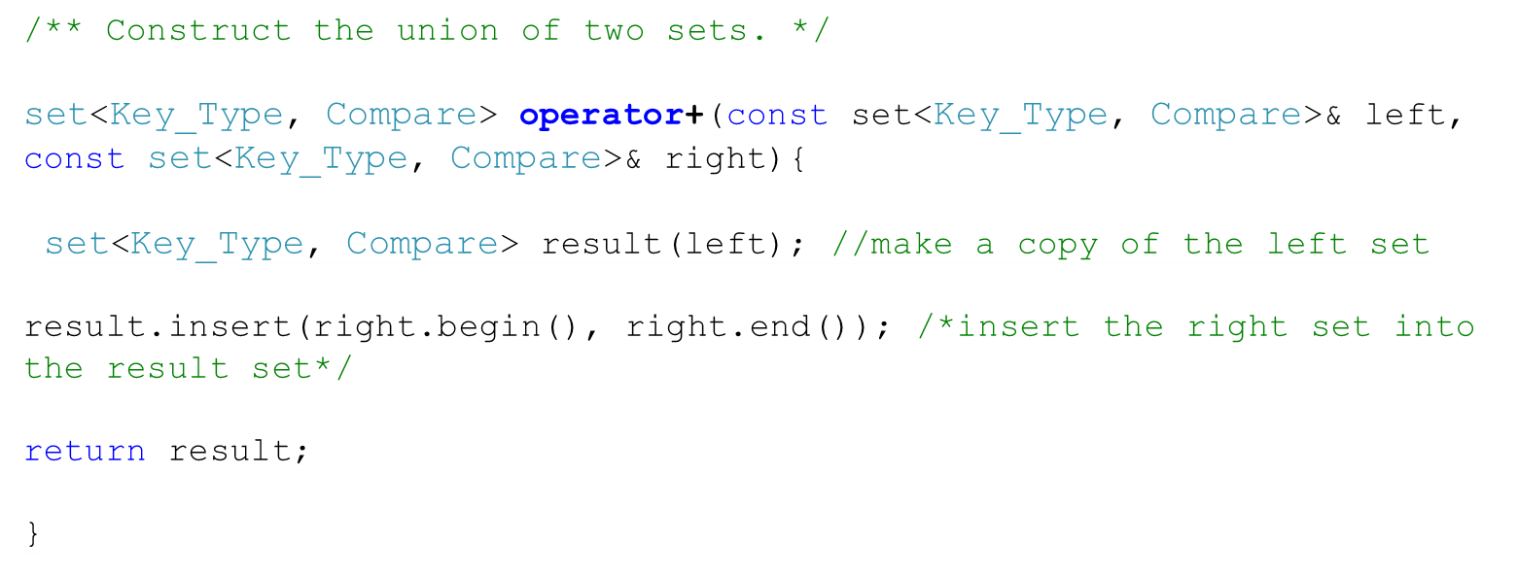
Implementing the Union Operator
Union:
“Apples”
“Grapes”
“Oranges”
“Peaches”
“Pineapples”
Left Set:
“Apples”
“Oranges”
“Pineapples”
Right Set:
“Apples”
“Grapes”
“Peaches”

Slide 6
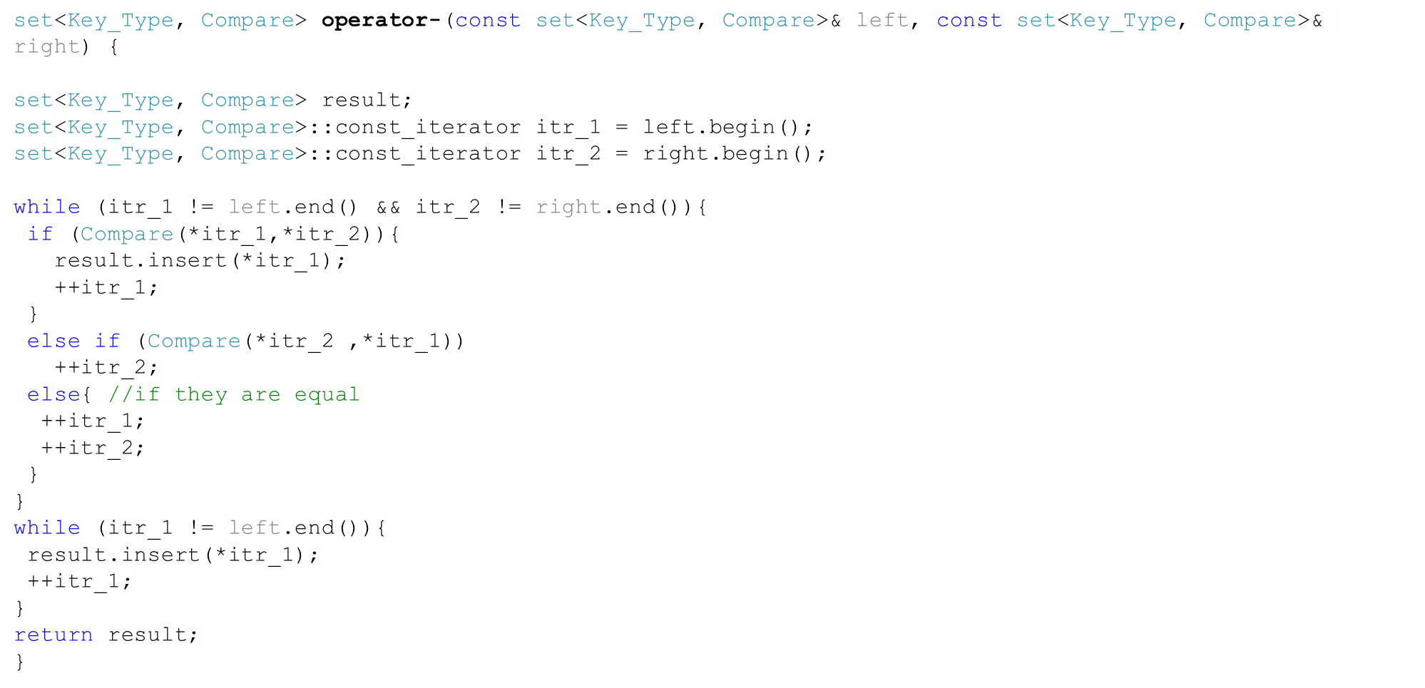
Implementing the Set Difference
Difference:
“Oranges”
“Pineapples”
Left Set:
“Apples”
“Oranges”
“Pineapples”
Right Set:
“Apples”
“Grapes”
“Peaches”

Slide 7

Task
Implement the intersection operator * for sets.
Left Set:
“Apples”
“Oranges”
“Pineapples”
Right Set:
“Apples”
“Grapes”
“Peaches”
Intersection
“Apples”

Slide 8
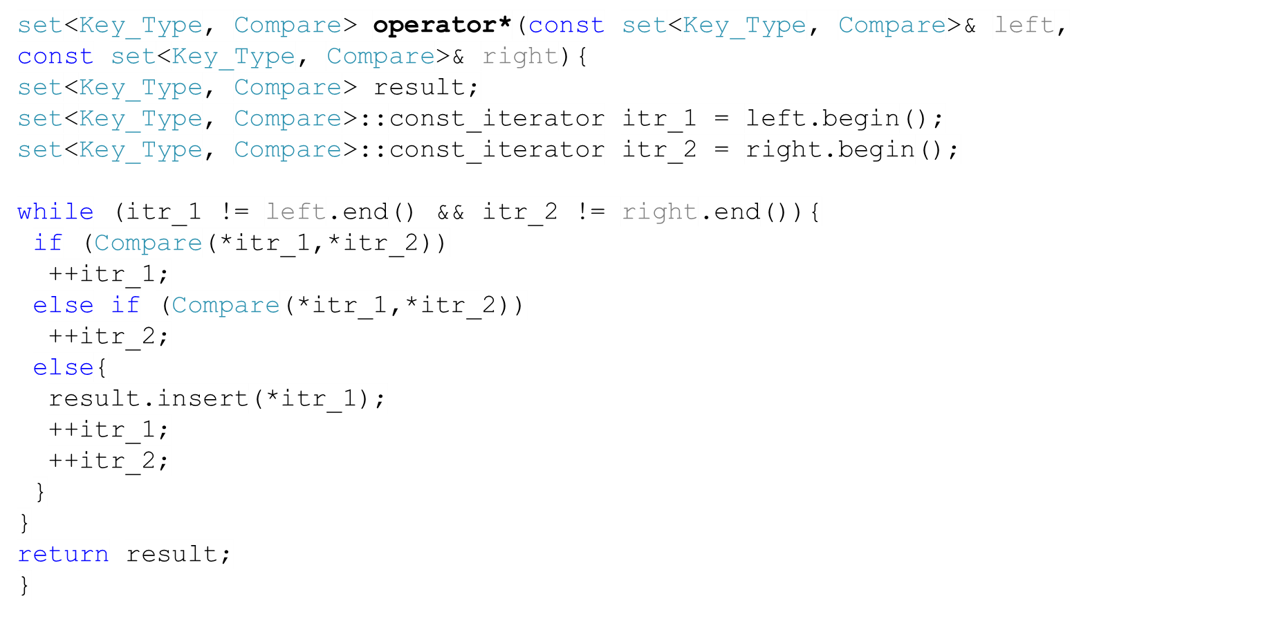
Solution
Left Set:
“Apples”
“Oranges”
“Pineapples”
Right Set:
“Apples”
“Grapes”
“Peaches”
Intersection
“Apples”

Slide 9
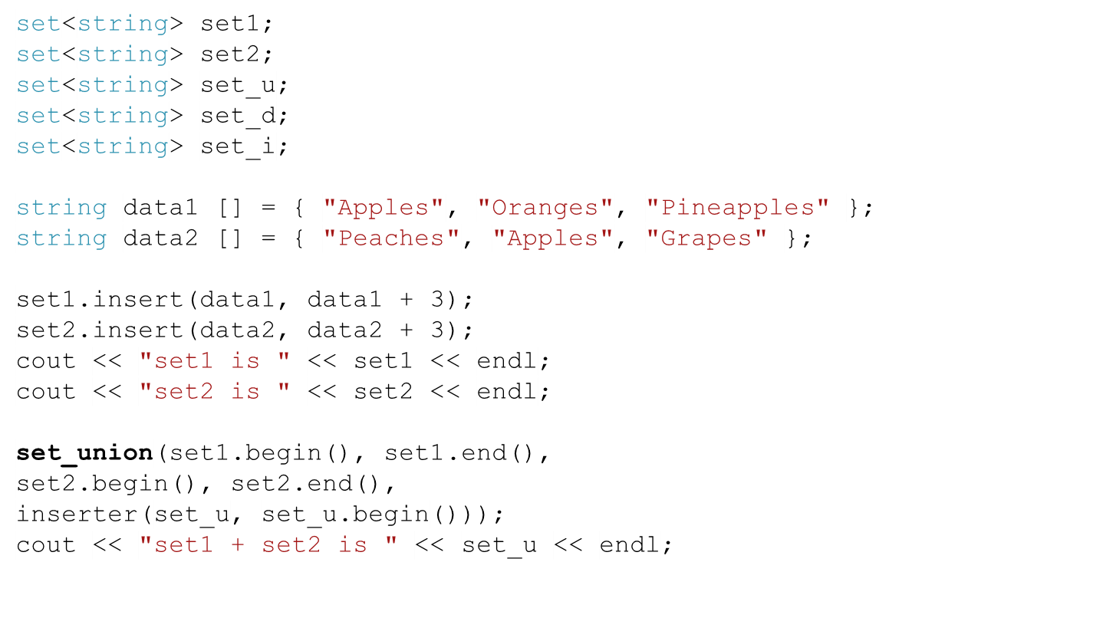

Set Example (1)
Union:
“Apples”
“Grapes”
“Oranges”
“Peaches”
“Pineapples”
Left Set:
“Apples”
“Oranges”
“Pineapples”
Right Set:
“Apples”
“Grapes”
“Peaches”

Slide 10
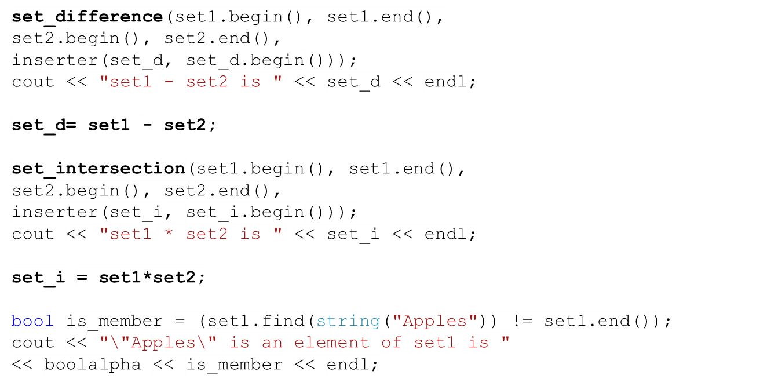

Set Example (2)
Intersection
“Apples”
Difference:
“Oranges”
“Pineapples”
Left Set:
“Apples”
“Oranges”
“Pineapples”
Right Set:
“Apples”
“Grapes”
“Peaches”

Slide 11
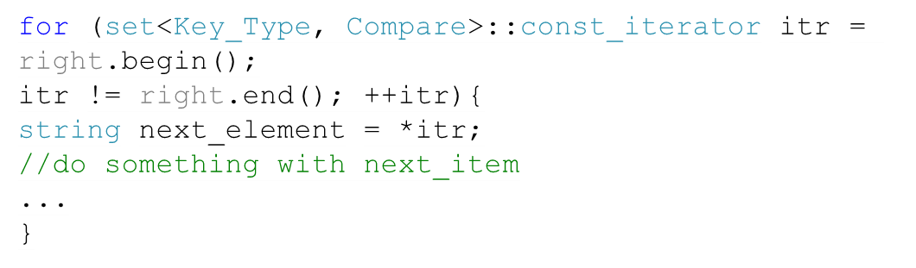
Vectors vs. Sets
Vectors | Sets
Containers of data | Containers of data
Items don’t have to be sorted. | Items are sorted
Have insert and erase functions | Have insert and erase functions
Elements don’t have to be unique. | Elements are unique
You must specify the location of the element you want to insert. | You don’t have to specify the location. Even if you do, it will be taken as a “hint” to speed up the insertion. Also, the insert function returns a bool value.
Has a subscript operator function (operator [ ] ) | You have to iterate through the elements.

Slide 12
Multisets
A Multiset is like a set, but doesn’t impose the requirement that the items be unique.
The insert always inserts a new item
The erase removes all occurrences of an item.
Function lower_bound returns an iterator to the first occurrence of the item if the item is present. If it is not present, it returns the same value as upper_bound.
Function upper_bound returns an iterator to the smallest item that is larger than the current item
lower_bound
upper_bound
Apples
Figs
Figs
Oranges

Slide 13
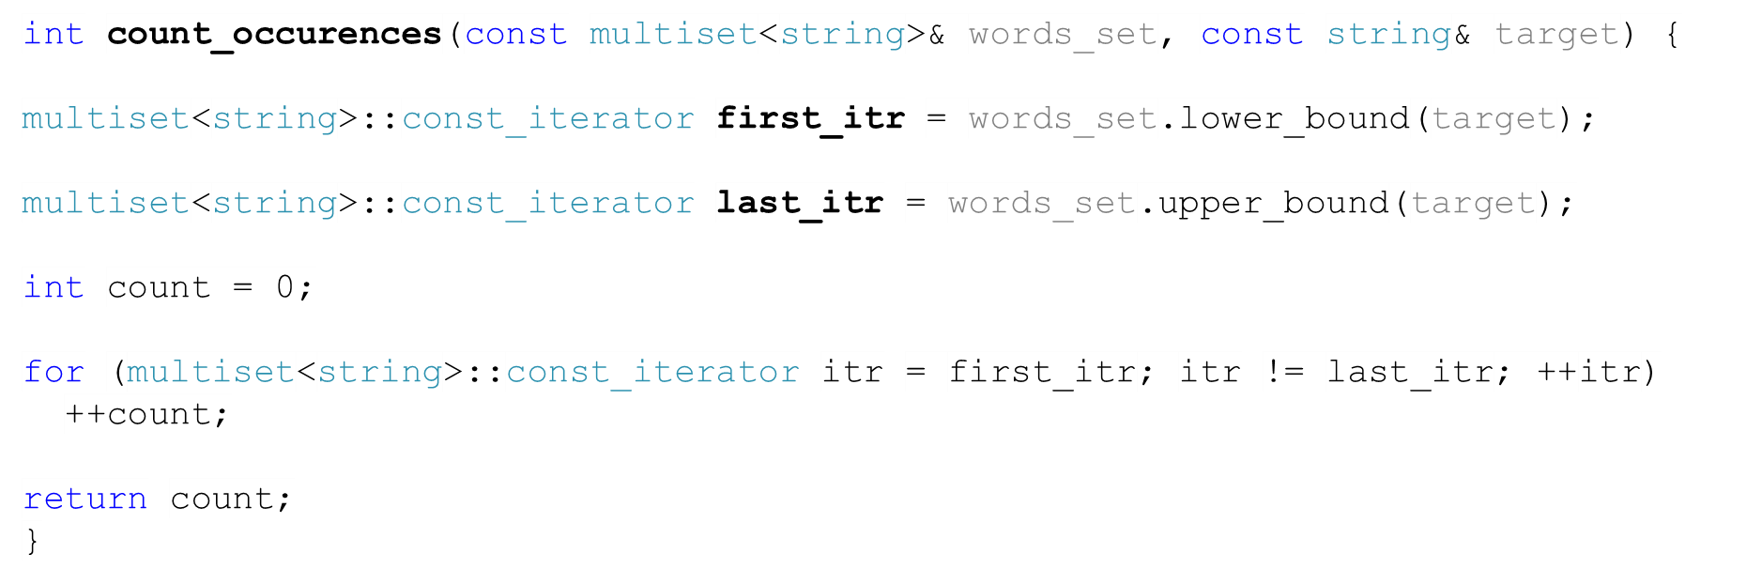
Count Occurrences in a Multiset
lower_bound
upper_bound
Apples
Figs
Figs
Oranges

Slide 14
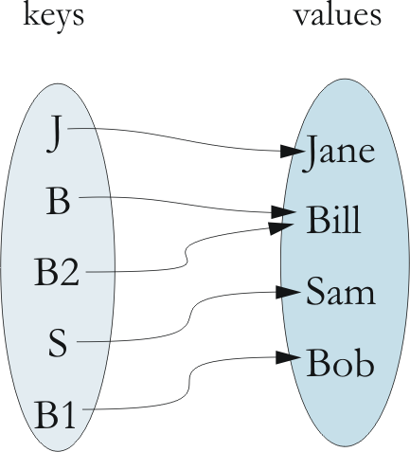
Maps
The map (also called associative arrays) is related to the set. Mathematically, it is a set of ordered pairs whose elements are known as the key and the value.
The key is required to be unique, but the value is not necessarily unique.
Example: { (J, Jane), (B, Bill), (S, Sam), (B1, Bob), (B2, Bill) }
A map can be used to enable efficient storage and retrieval of information in a table.

Slide 15
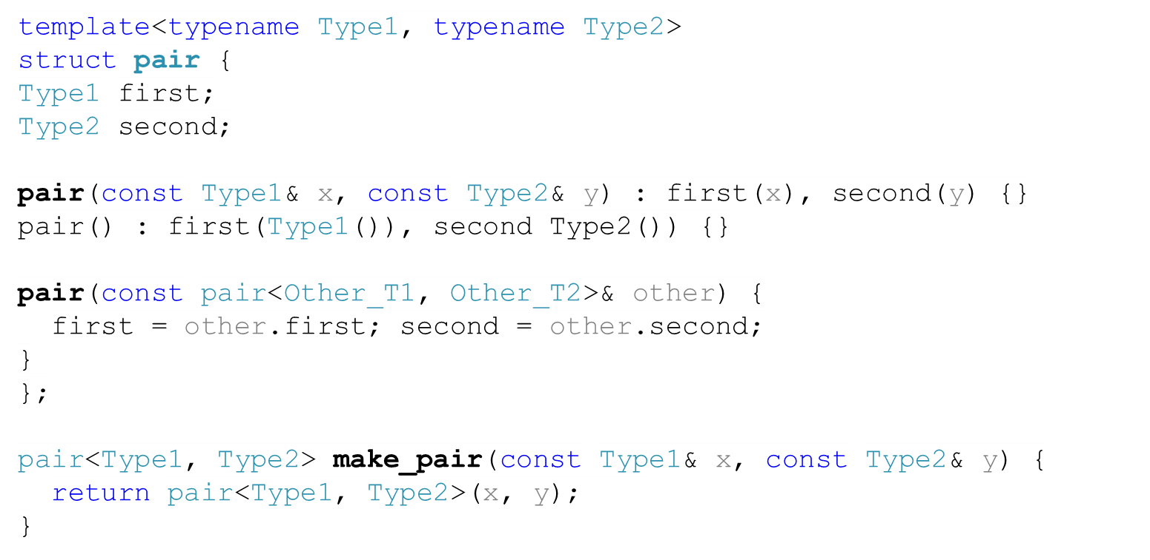
The pair struct

Slide 16
Example on Maps
Type of Item | Key | Value
University student | Student ID | Student name, address, major, GPA
Customer for on-line store | E-mail address | Customer name, address, credit card information, shopping cart
Inventory item | Part ID | Description, quantity, manufacturer, cost, price
Difference between maps and indexed collections (e.g. vectors)?

Slide 17
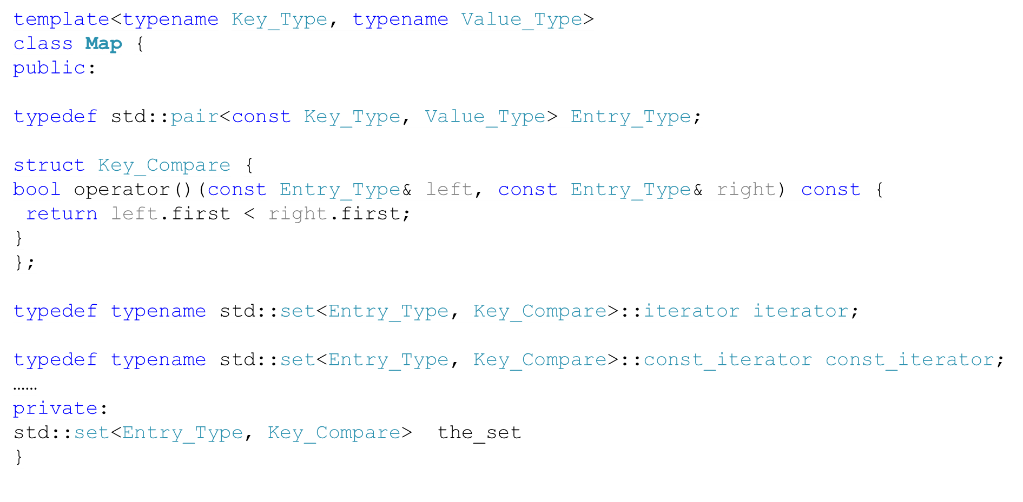
The Map class (1)

Slide 18
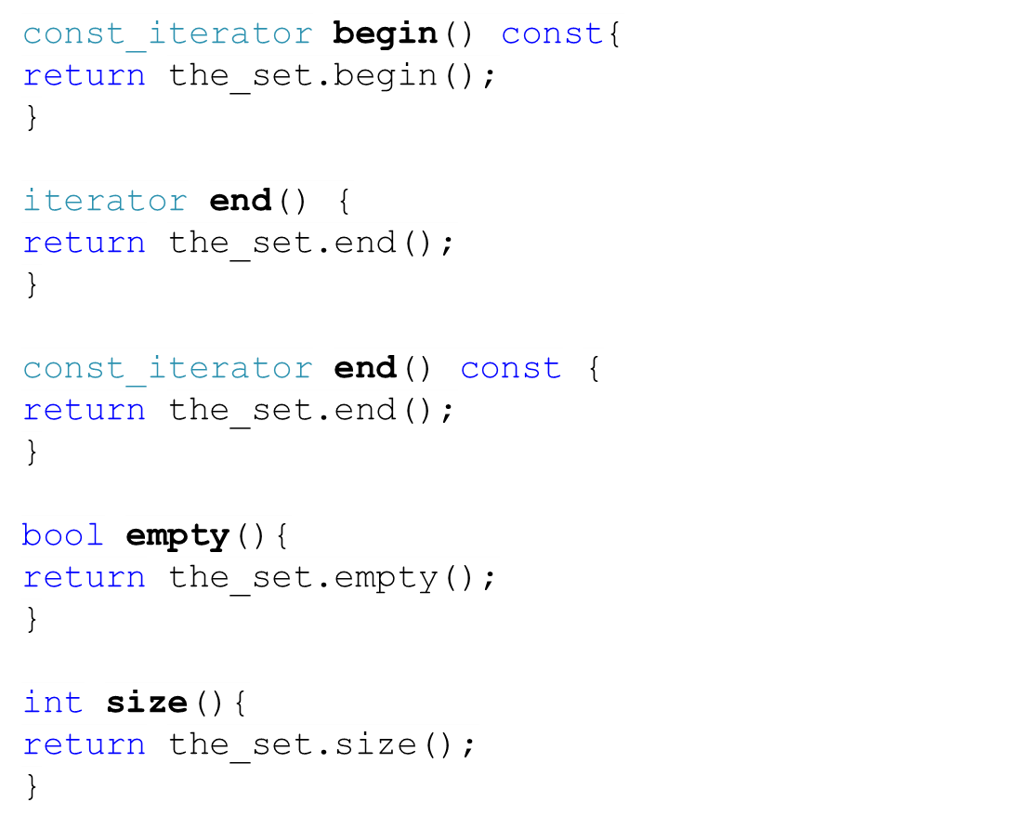
The Map class (2)

Slide 19
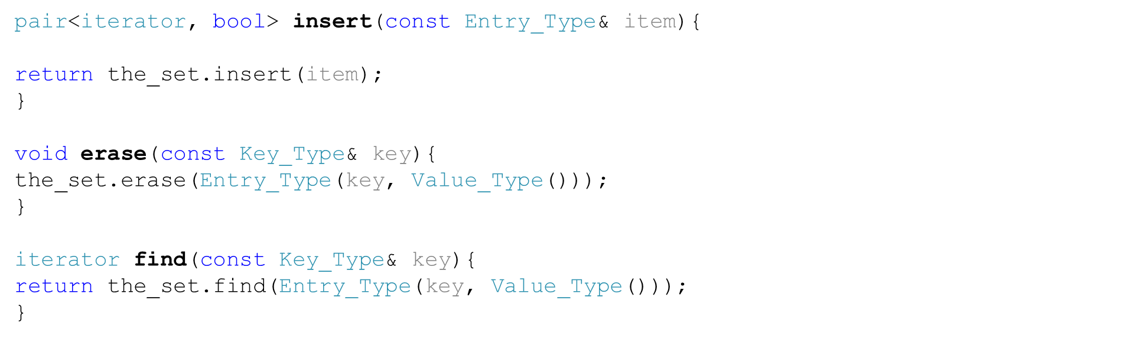
The Map class (3)

Slide 20
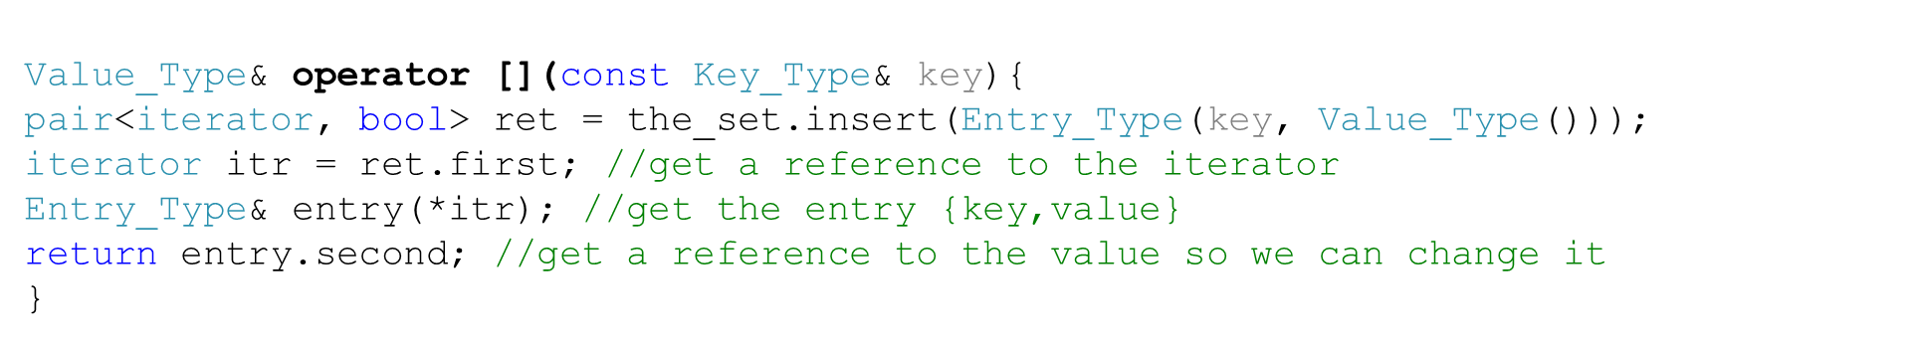
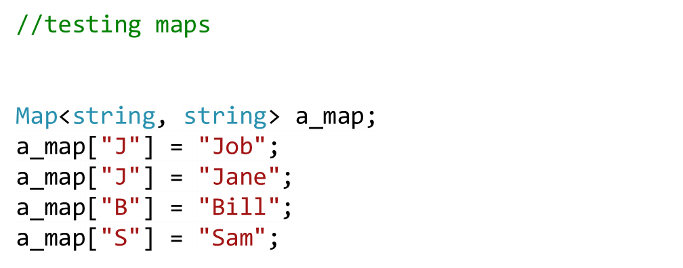
The Map class (4)
key | Value
“B” | “Bill”
“J” | “Jane”
“S” | “Sam”
“B” | “Bill”
“J” | “Jane”
“Jane”
“Job”
“J” | “”

Slide 21
Task
Using maps, design a program that keeps track of employees and the departments they work in. Employees and departments have unique IDs. Each employee may work in one department. A department may have many employees.
How would you keep track of departments and employees? Draw a class diagram to illustrate your idea.
Write a function that retrieves the department information for an employee.
Employee
Department
*
1
name: string
Id: string
name: string
Id: string

Slide 22
Task - Solution
ID, Name, DateOfBirth, dept_ID
ID, Name
Employee
Department
One employee may have zero or one department
One department may have zero or one employees
Employee
Department
ID | Name | dept_ID
1 | Samir | CS
2 | Jane | CS
3 | Smith | IT
ID | Name
CS | Computer Science
IT | Information Technology
BI | Biology

Slide 23
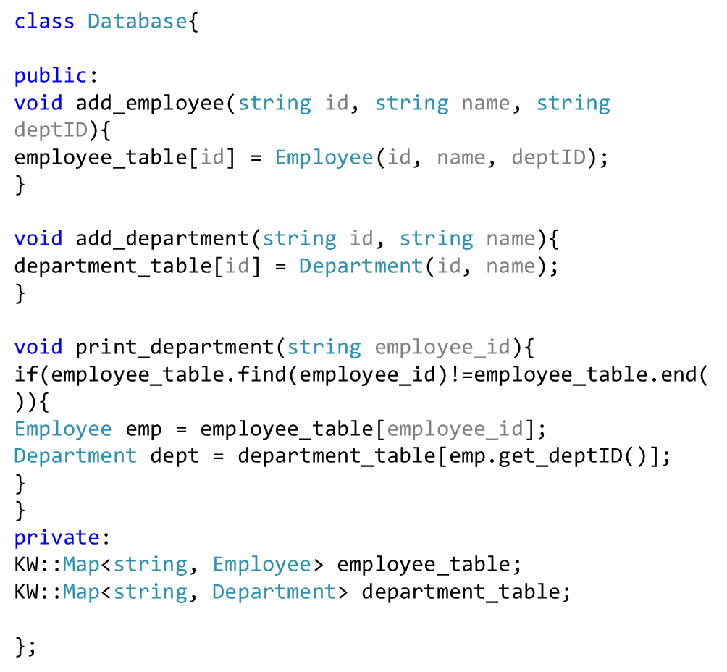
Task - Solution
Employee
Department
*
1
name: string
Id: string
deptID: string
name: string
Id: string
*
*
1
1
Map<string, Employee>
Map<string, Department>
1
1
1
1
Database
+ add_employee(name: string,id:string ,deptID: string): void
+ add_department(name:string, id:string): void
+ get_department( name:string): void

Slide 24
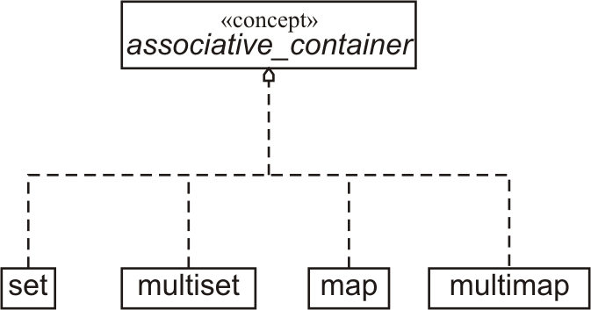
Associative Containers

Slide 25
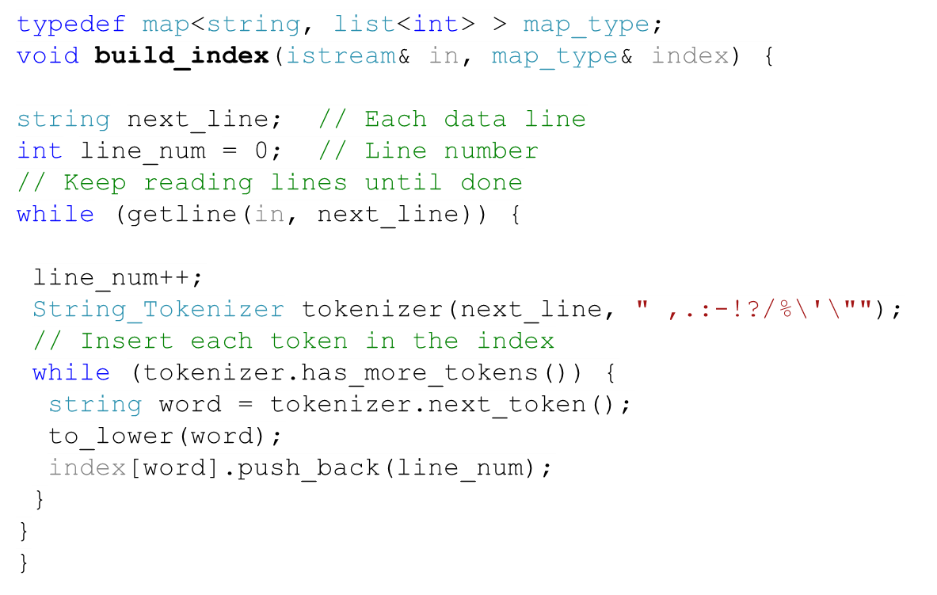
Using Map to Build an Index
key | Line Number
app | 1
car | 1
book | 2, 3
book | 2
car | 1
car | 1
mouse | 3
job | 3
mouse | 3
Problems with the code?
allows duplicate values
Task: write a function that prints the index
"car app \n book \n book mouse job"

Slide 26

Using Map to build a Phone Directory (1)
Index | Value
Jane Smith | 215-555-1234
John Smith | 215-555-1234
Bill Jones | 508-555-6123
allows duplicate values

Slide 27
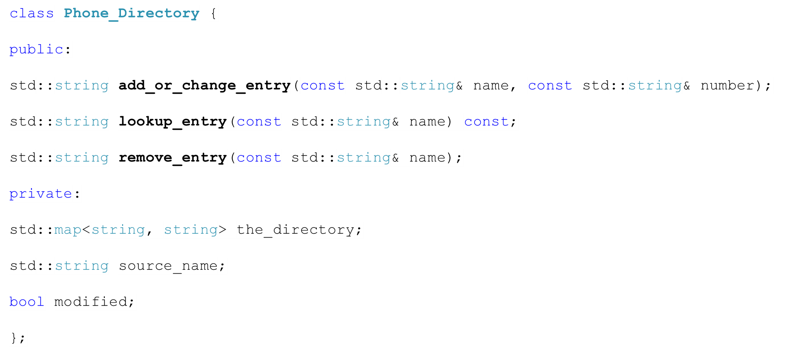
Class Phone_Directory
allows duplicate values

Slide 28
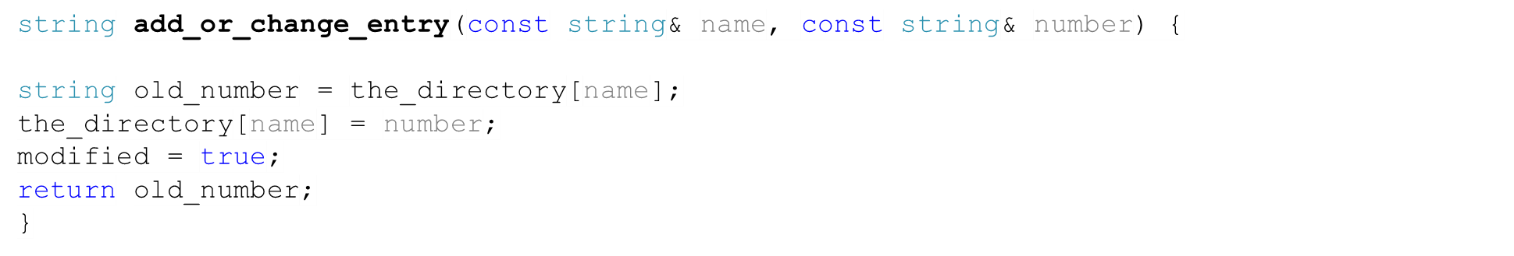
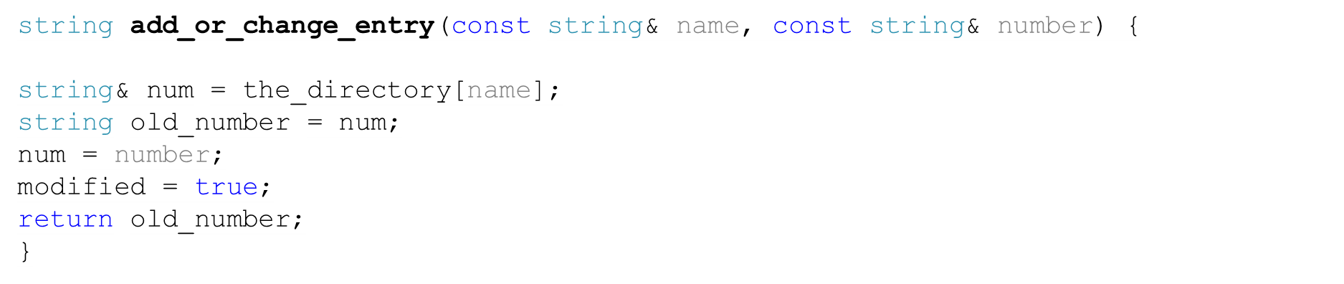
Function add_or_change_entry
allows duplicate values

Slide 29
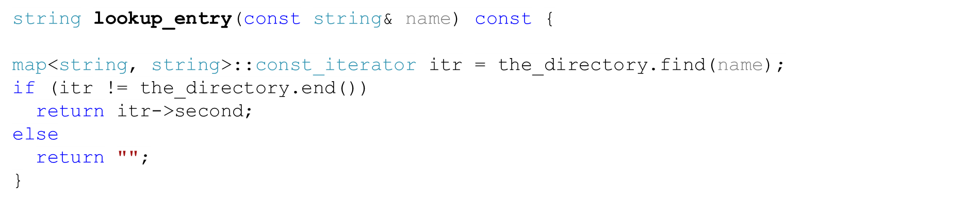
Function lookup_entry
allows duplicate values

